Slide 1
Validation Studies with the Space Weather Modeling Framework
T.I. Gombosi, G. Toth, I.V. Sokolov, D.L. De Zeeuw,
W.B. Manchester, A. J. Ridley, R.A. Frazin, B. van der Holst,
O. Cohen, D. Welling, A. Glocer
University of Michigan

Slide 2
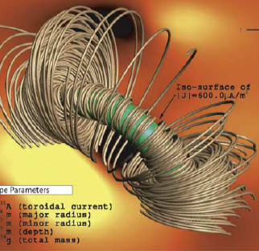
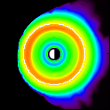
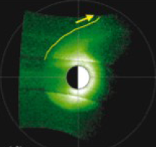
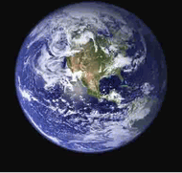
Space Weather Modeling Framework (SWMF)
Flare/CME
Observations
Upstream
Monitors
SWMF Control & Infrastructure
Eruption
Generator
Radiation
Belts
Energetic
Particles
Polar Wind
Plasmasphere
3D Inner
Heliosphere
Couplers
F10.7 Flux
Gravity
Waves
Global
Magnetosphere
Thermosphere
& Ionosphere
3D Corona
Graphical
User
Interface
Inner
Magnetosphere
Ionospheric
Electrodynamics
Lower
Atmosphere
Synoptic
Magnetograms
Radars
Magnetometers
In-situ

Slide 3
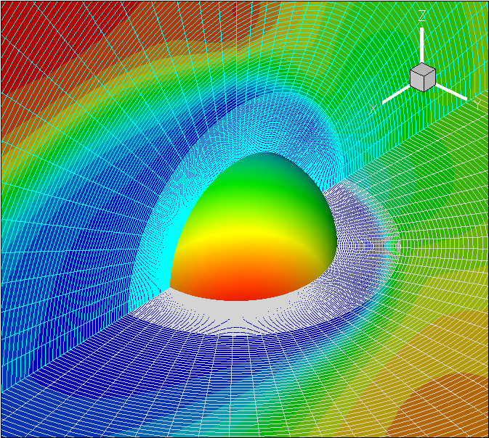
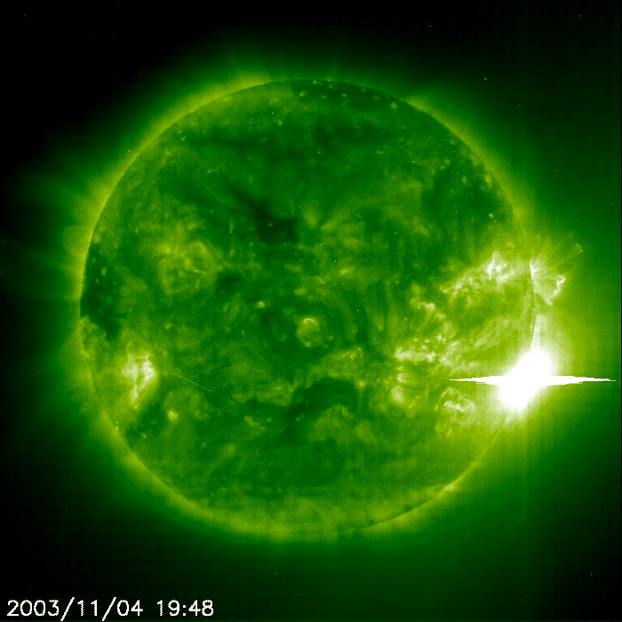
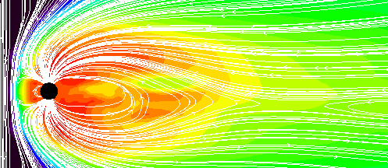
BATS-R-US is a Multi-Physics Code
Compressible fluid dynamics
Ideal MHD with mass addition
Resistive MHD
Current driven resistivity models
Non-gyrotropic resistivity model
Hall MHD
Keeps the Hall term in Ohm’s law
More realistic reconnection rate
Semi-relativistic MHD
Displacement current is kept in Ampère’s law
Limits all wave speeds by c
Physics-based energy transport
Heat conduction
Wave energy transport
Multi-species/Multi-fluid MHD
Separate continuity, momentum and energy equations

Slide 4
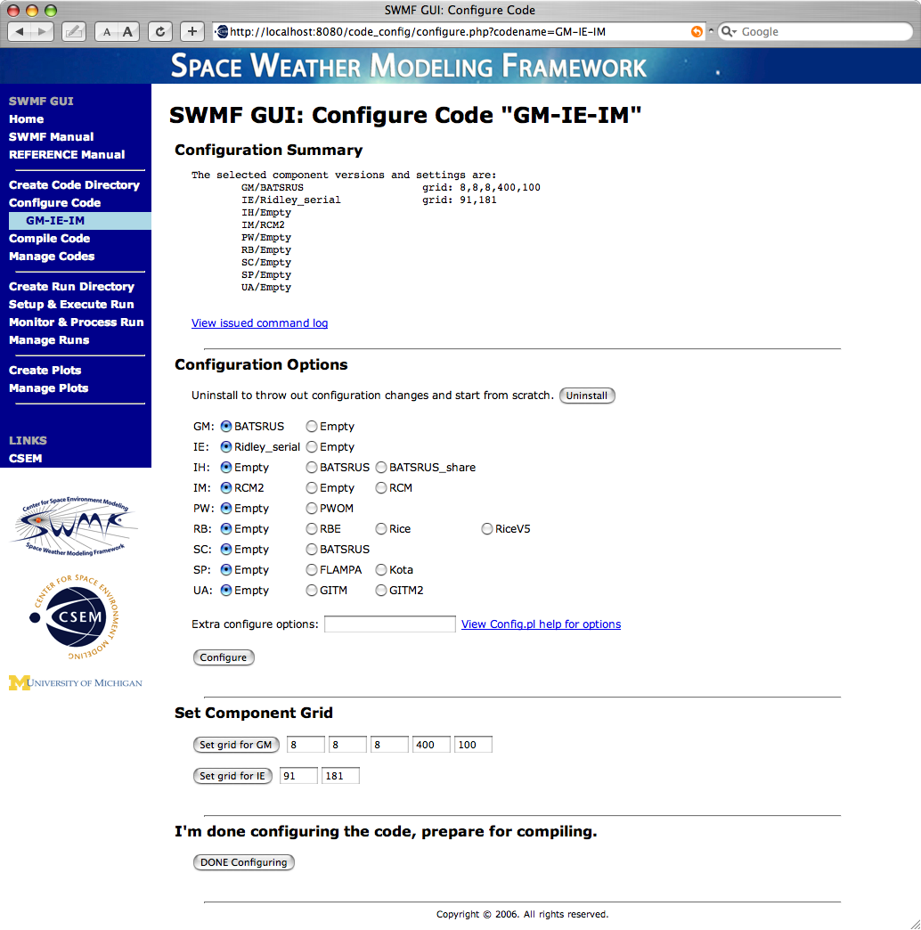
GUI: Code Cotrol (De Zeeuw)
Components of the framework can be easily selected for use.
Some components have multiple versions or even alternative models.

Slide 5
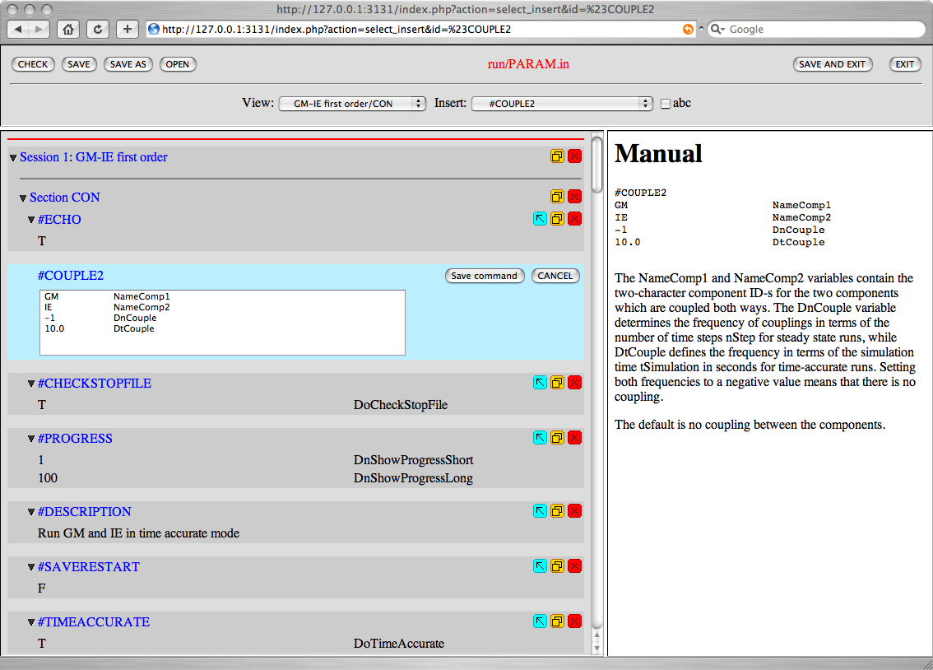
GUI: Parameter Editor (Toth)

Slide 6
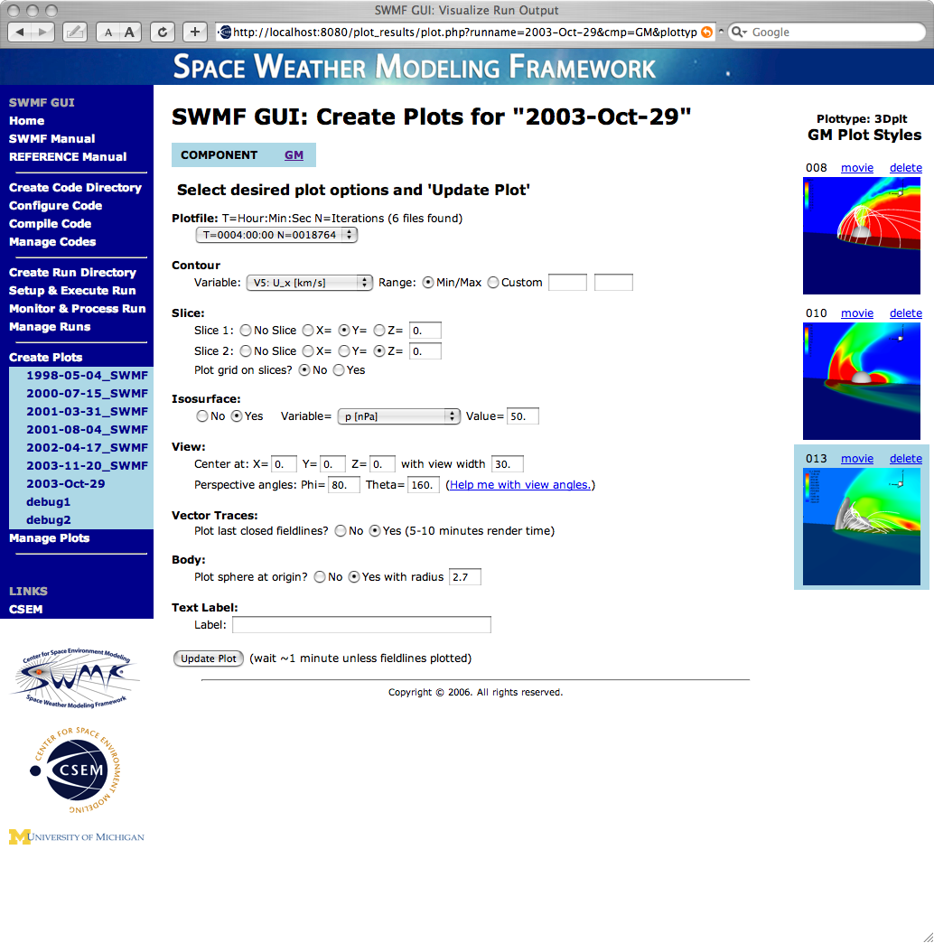
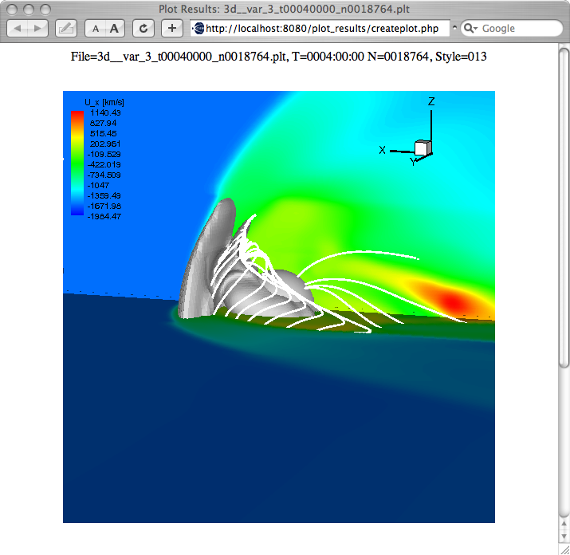
GUI: Visualization (De Zeeuw)
Visualize output with templates with many options.
Uses IDL and/or Tecplot
Outputs postscript, png, animated gif, etc.

Slide 7
Magnetospheric Validation (Welling & Ridley)
10 events were simulated, covering quiet to extremely stormy space weather conditions
Simulations use a coupled BATS-R-US (GM), RCM (IM) and RIM (UA)
Grid resolution is 1/4 RE near body, 1/2 RE in the inner magnetosphere, 1-8 RE in the distant tail
Each simulation was executed on NASA’s “Columbia” system using 32 PEs
Using this setup and these resources, each simulation was completed in real or near-real time (~750 CPU hours per simulated day)

Slide 8
SWMF Metrics Results (Welling & Ridley)
 | nRMSE |  |  |  | Correlation Coefficient
Orbit Type | Bx | By | Bz | |B| | Bx | By | Bz | |B| | n
Polar | 0.362 | 0.339 | 0.343 | 0.156 | 0.947 | 0.931 | 0.941 | 0.980 | 9
Geosynchronous | 0.538 | 0.493 | 0.573 | 0.284 | 0.770 | 0.866 | 0.701 | 0.442 | 15
Outer Magnetosphere | 0.794 | 0.736 | 0.669 | 0.476 | 0.638 | 0.666 | 0.607 | 0.532 | 6
 | >100eV H+ |  | >30eV e-
(n=19) | Density | Temperature | Density | Temperature
nRMSE | 0.961 | 0.990 | 1.096 | 1.208
Corr. Coeff | 0.274 | 0.177 | 0.266 | 0.096
Without cold plasma sources in RCM, density is too low and temperature is too high.
Warm particles (>100eV) are reasonably well modeled.
Next: Correlate pressure

Slide 9
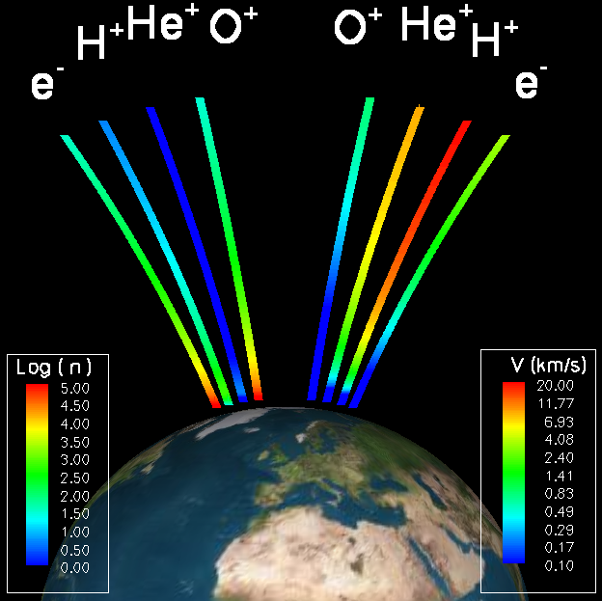
Polar Wind Outflow Model (PWOM) (Glocer)
PWOM solves the time-dependent gyrotropic field aligned transport equations for H⁺, O⁺, He⁺ and electrons
The lower boundary is at 200km, and the upper boundary is at a few Earth Radii
Multiple convecting field-lines solutions are obtained
The neutral thermosphere model is externally specified (F10.7 and solar cycle effects can be included)
Ion-neutral friction, charge exchange drag, topside heating, solar zenith angle effects, chemical sources and losses are included

Slide 10
May 4, 1998 Event - Outflow Flux (Glocer)

Slide 11
Magnetospheric Plasma Composition (Glocer)

Slide 12
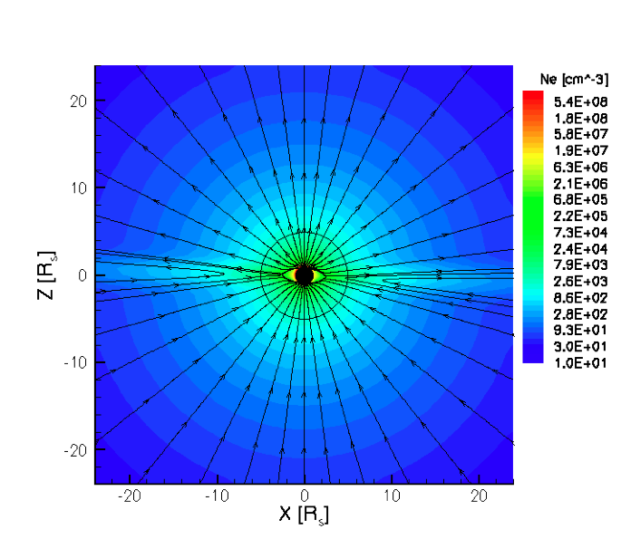
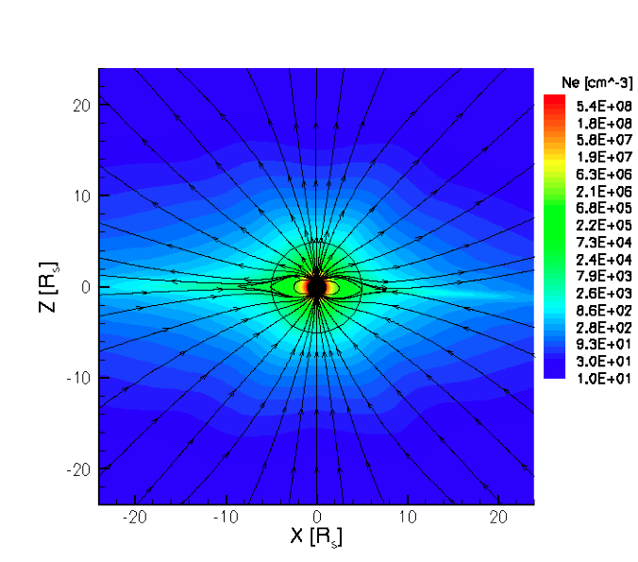
Constrained Solar Wind MHD Models (Cohen & Sokolov)
n_{e}-MHD: We specify the boundary conditions for γ using an empirical, magnetic latitude dependent electron density distribution extracted from white-light images (Guhathakurta et. al, JGR, 111, 2006). Because the magnetic field is independently obtained, the electron density distribution is not fully consistent with the magnetic field distribution.
WSA-MHD: We specify the boundary conditions for γ using the asymptotic solar wind speed calculated by the WSA model that uses the potential field expansion factor to calculate the final solar wind speed. We also scale the base density and temperature with the expansion factor so the physical parameters are derived self-consistently (but not necessarily correctly).
Initial (empirical) n_{e} and the potential field distribution.
MHD steady state solution for n_{e} and magnetic field distribution.

Slide 13
WSA-MHD: Statistics (Cohen & Sokolov)
 | Solar Minimum |  | Solar Maximum
 | Cross-corr. | RMS | Cross-corr. | RMS
u | 0.82 | 27% | 0.79 | 29%
n | 0.35 | 87% | 0.32 | 97%
B | 0.40 | 59% | 0.50 | 62%
T | 0.40 | 65% | 0.32 | 75%

Slide 14
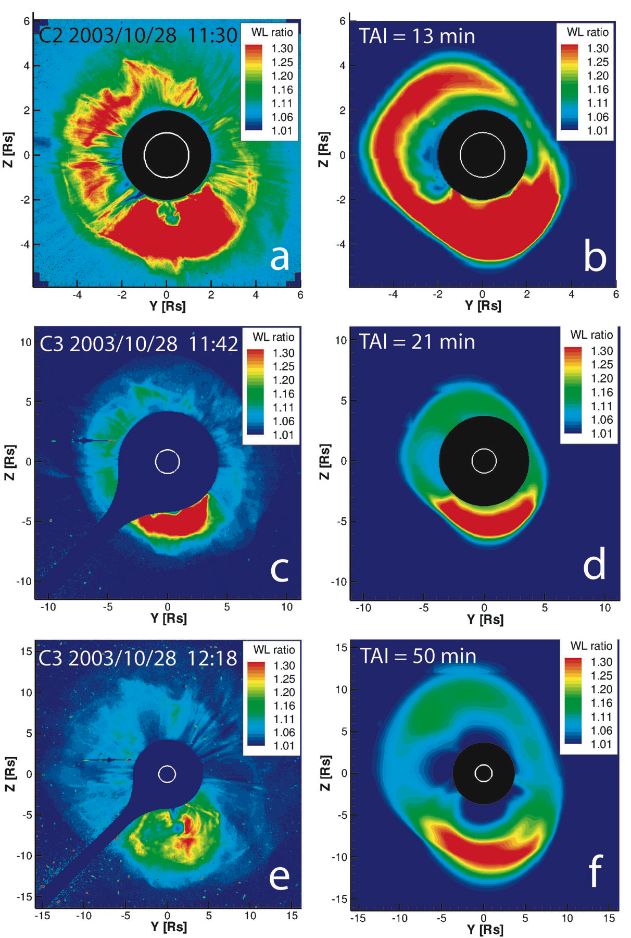
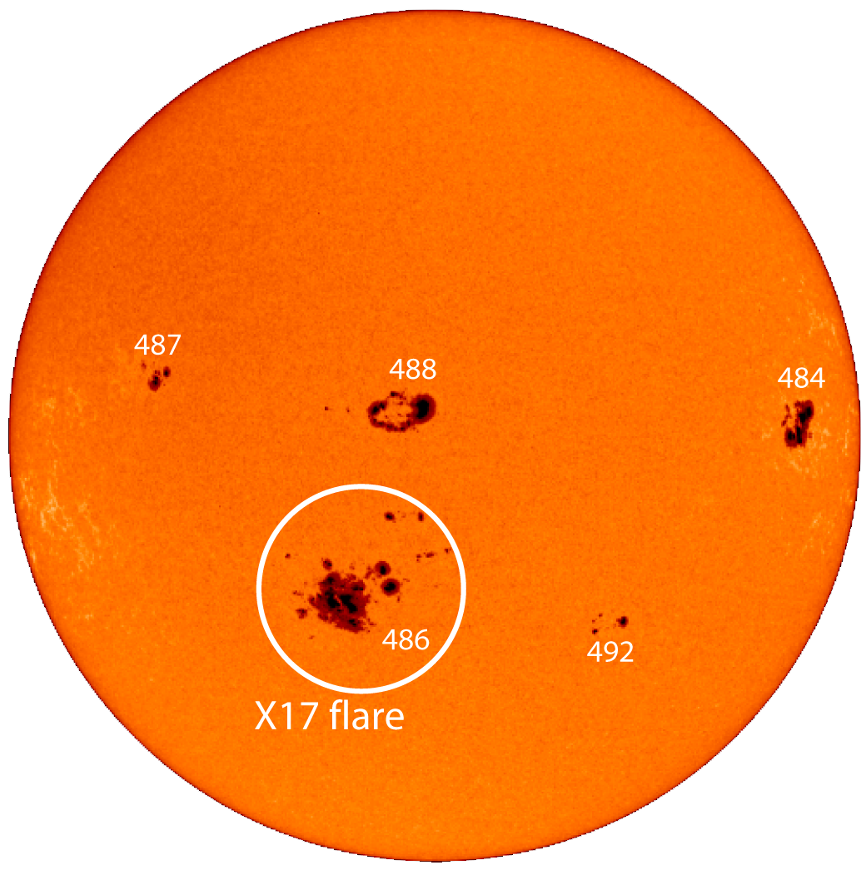
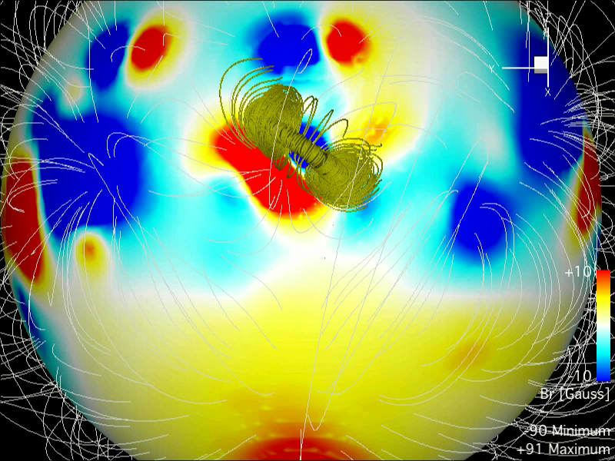
Erupting Flux-Rope CME Initiation Model (Manchester)
Halloween storm simulation
with synoptic wind background
and erupting flux rope CME
initiation model
October 28, 2003
SOHO/MDI

Slide 15
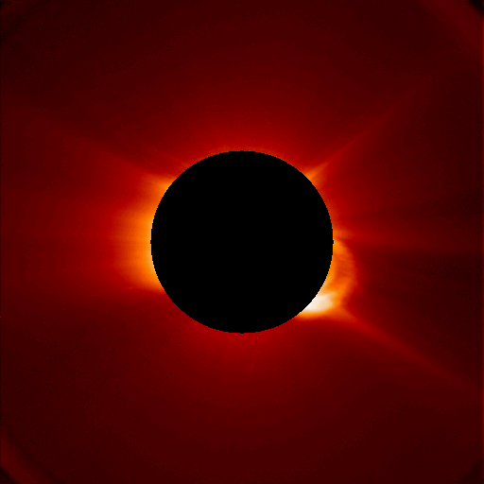
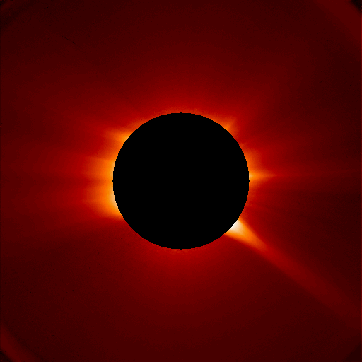
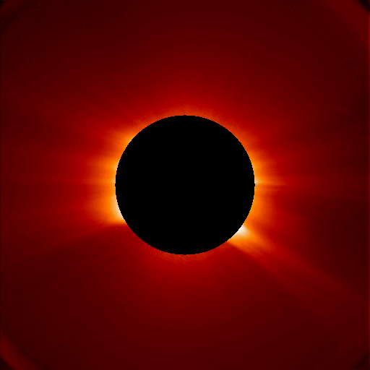
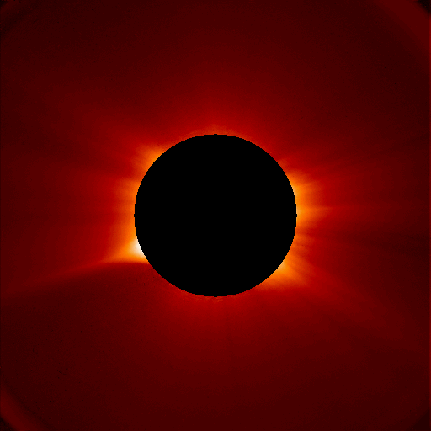
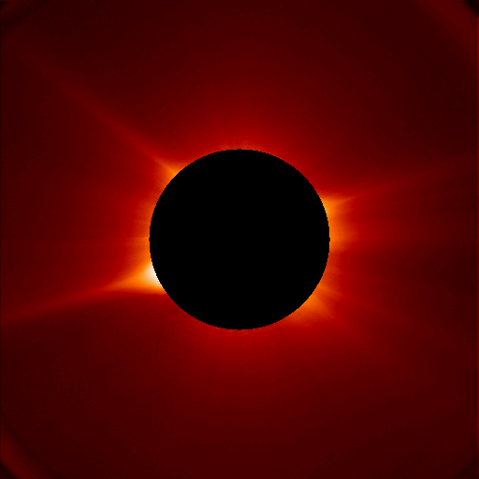
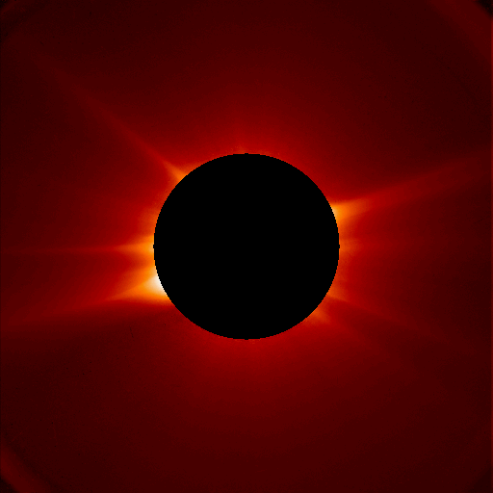
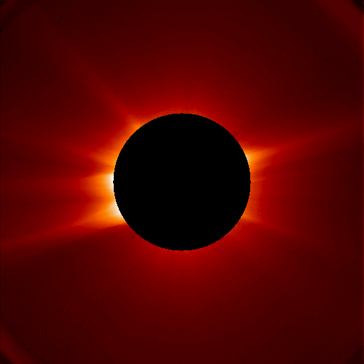
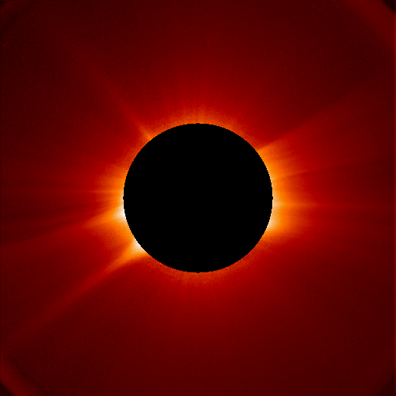
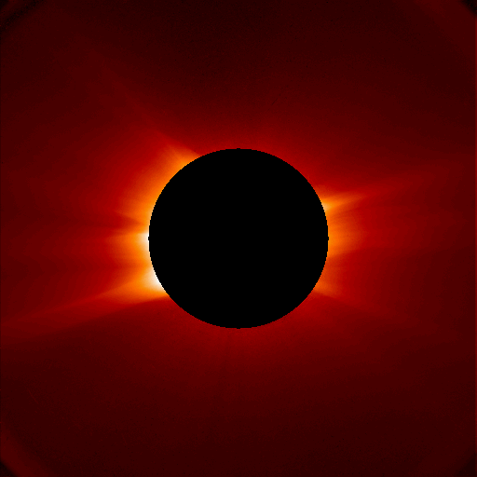
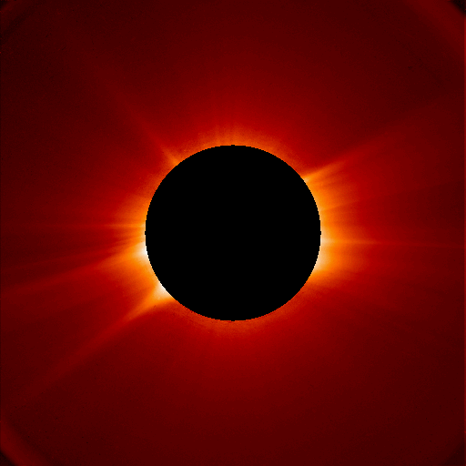
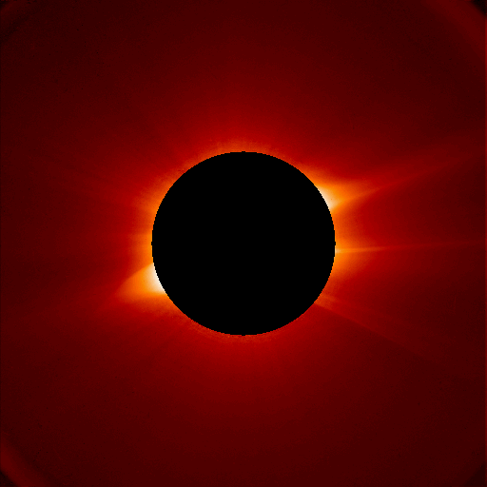
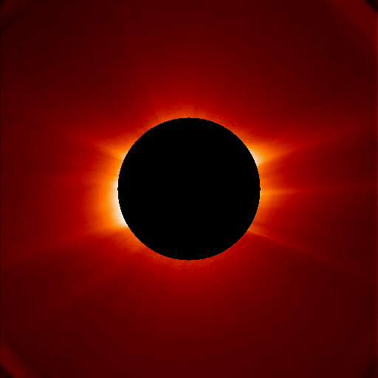
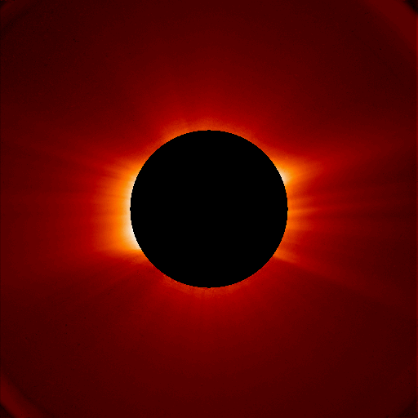
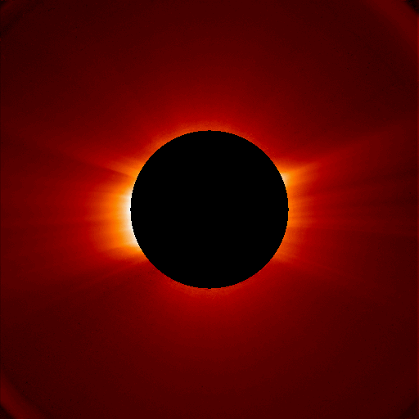
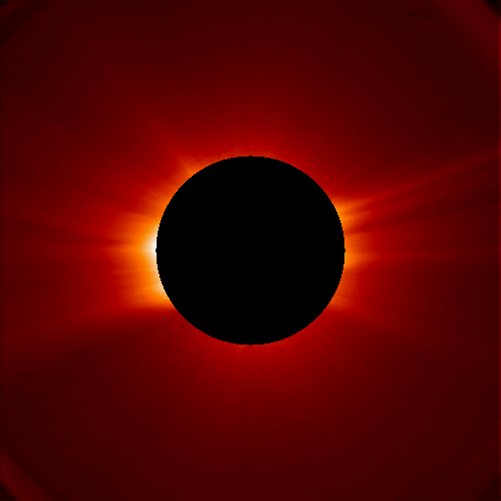
SOHO C2 2005 05 15 21:05
SOHO C2 2005 05 17 21:05
SOHO C2 2005 05 19 21:05
SOHO C2 2005 05 14 21:03
SOHO C2 2005 05 16 21:00
SOHO C2 2005 05 18 21:00
3D tomography is an important tool of model validation and offers important advances in data assimilation. Using line-of-sight image inversion technology we can reproduce the global coronal electron density distribution from a time-series of coronagraph images (assuming steady-state). It takes half a solar rotation of imaging data to create a full 3D electron density distribution between 1 R_{s} and ~6 R_{s}.
SOHO C2 2005 05 20 21:00
SOHO C2 2005 05 27 23:44
SOHO C2 2005 05 21 0306
SOHO C2 2005 05 27 21:00
SOHO C2 2005 05 26 21:05
SOHO C2 2005 05 24 21:05
SOHO C2 2005 05 22 21:05
SOHO C2 2005 05 25 21:00
SOHO C2 2005 05 23 21:00
SOHO C2 2005 05 21 21:05

Slide 16
Tomography and MHD Comparison (Frazin & Cohen)
10⁵/cc isosurface

Slide 17
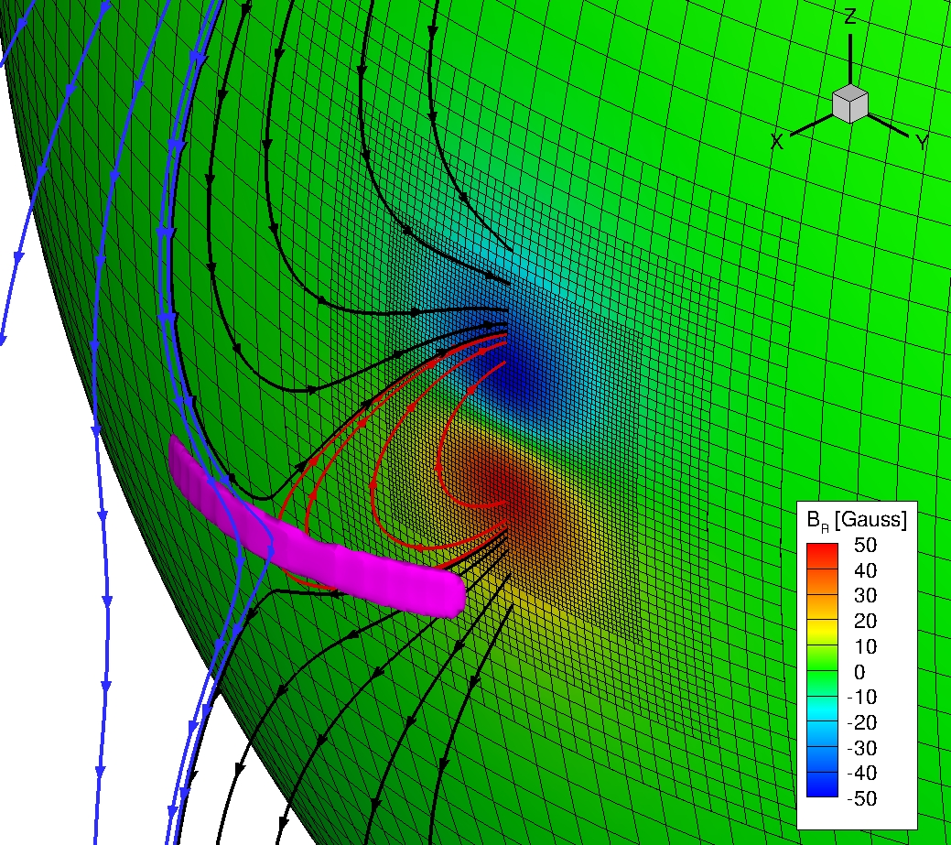
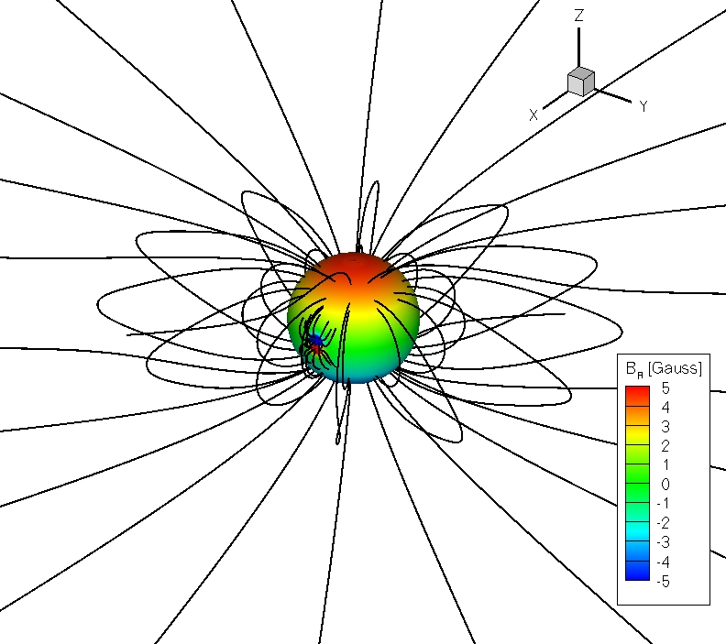
Breakout Simulation Geometry (Bart van der Holst)

Slide 18
2D Breakout Simulation (Bart van der Holst)

Slide 19
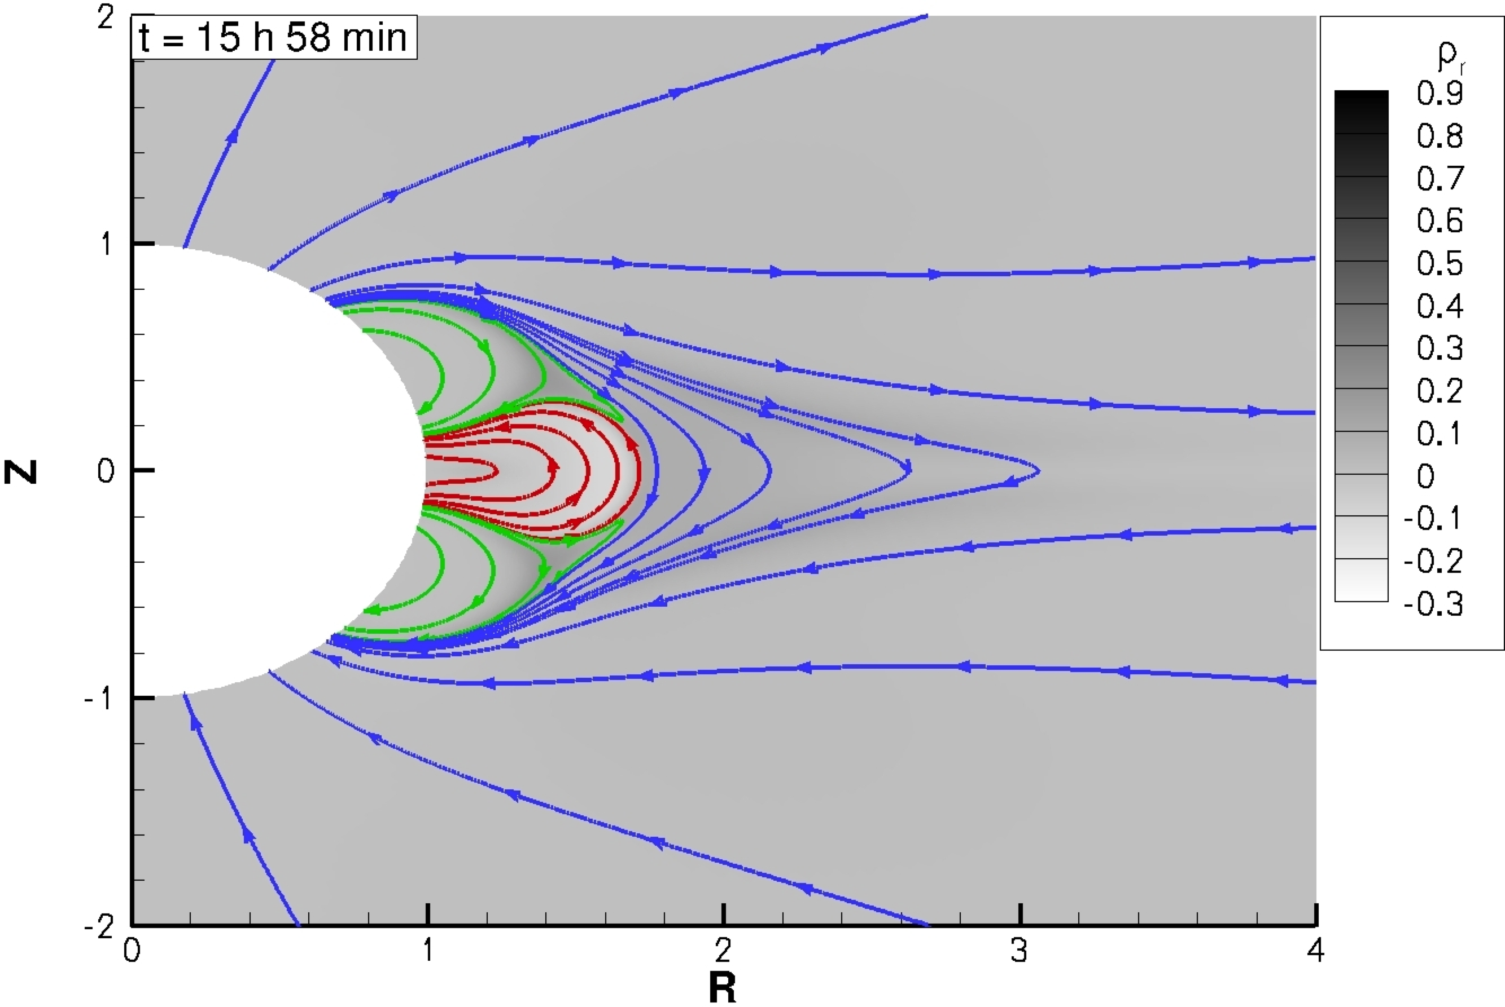
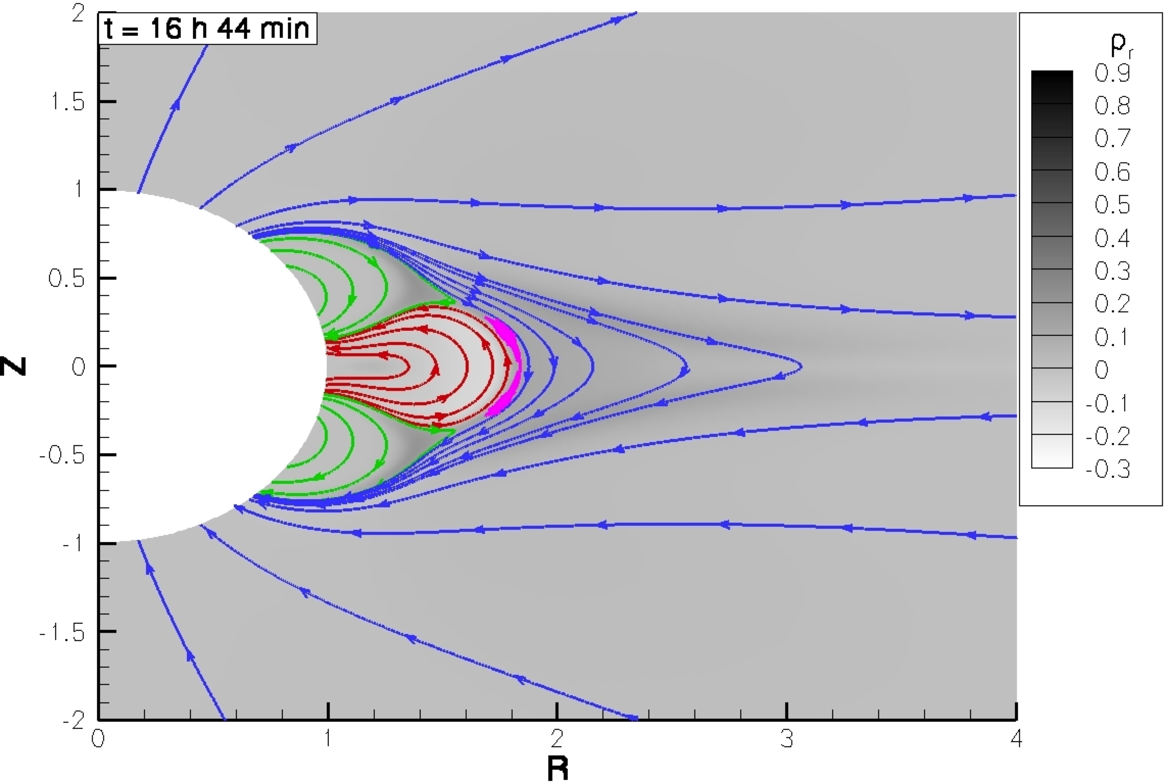
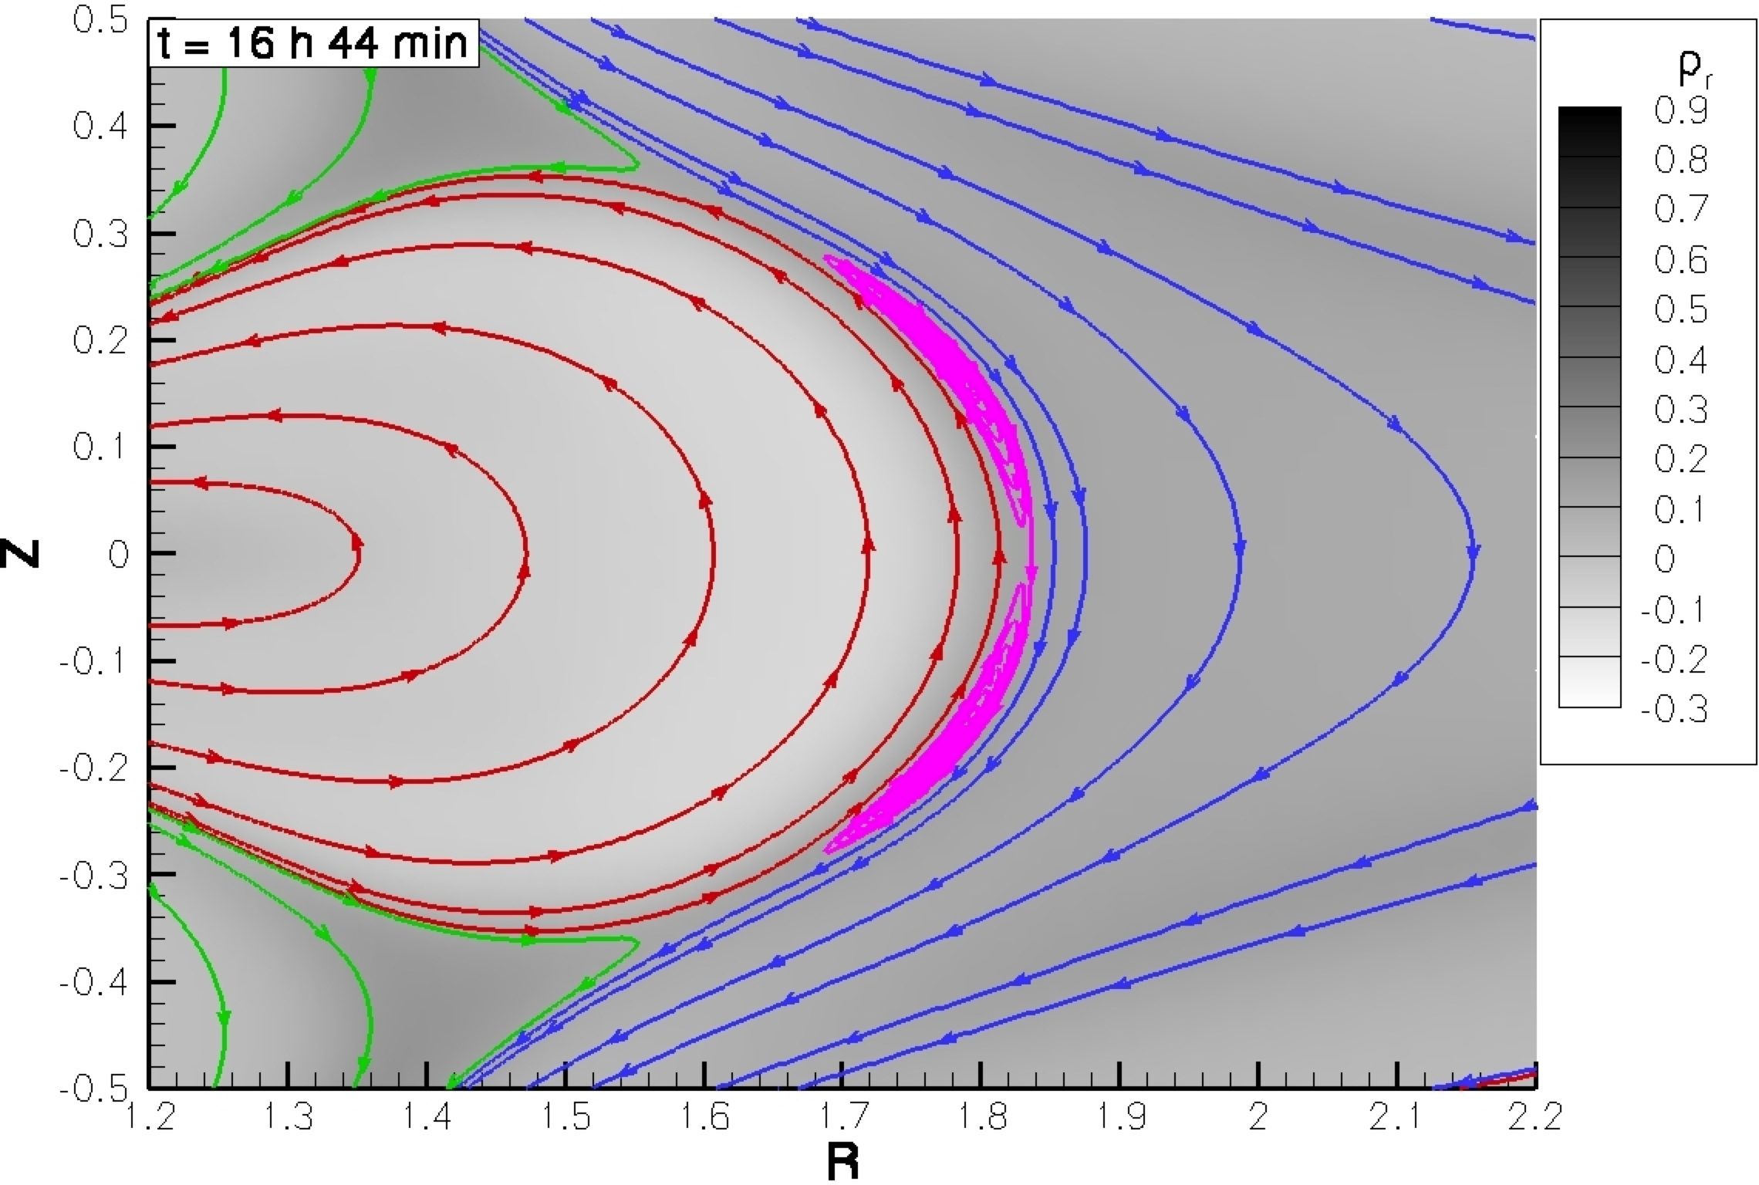
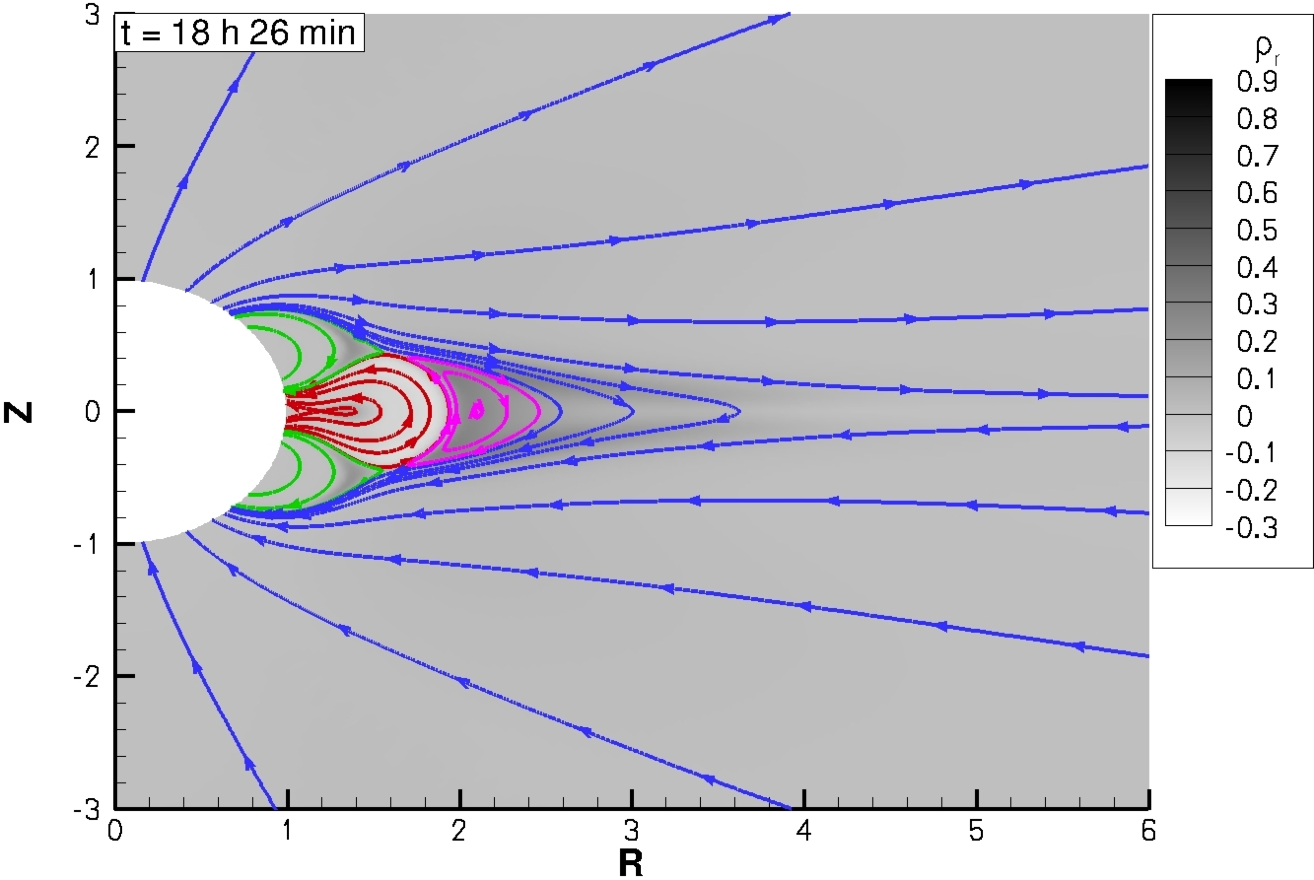
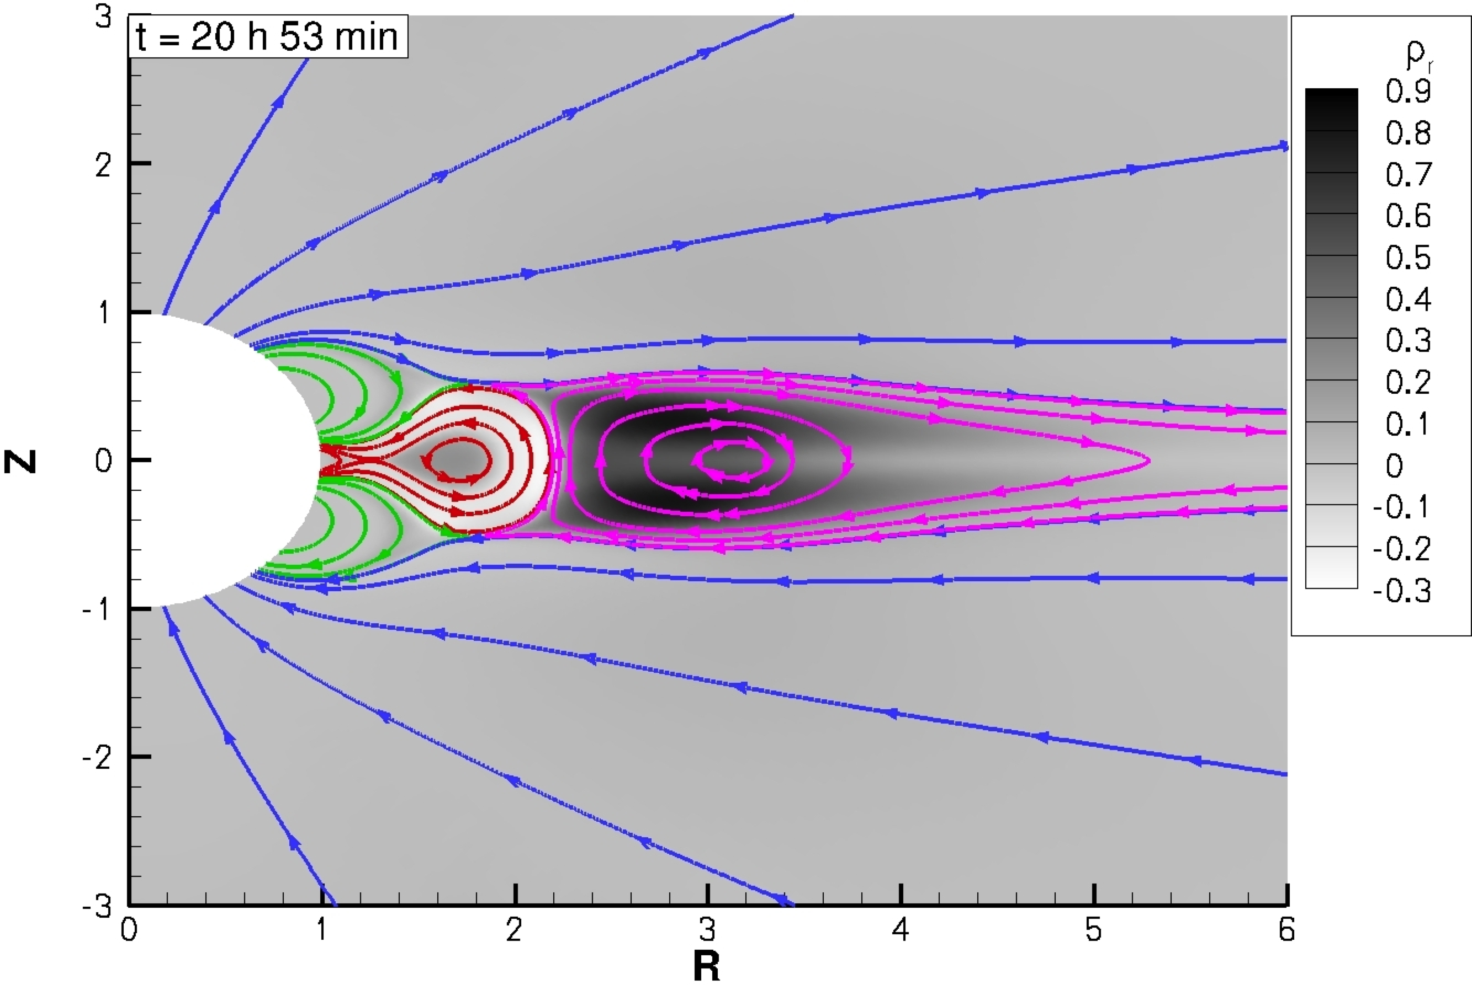
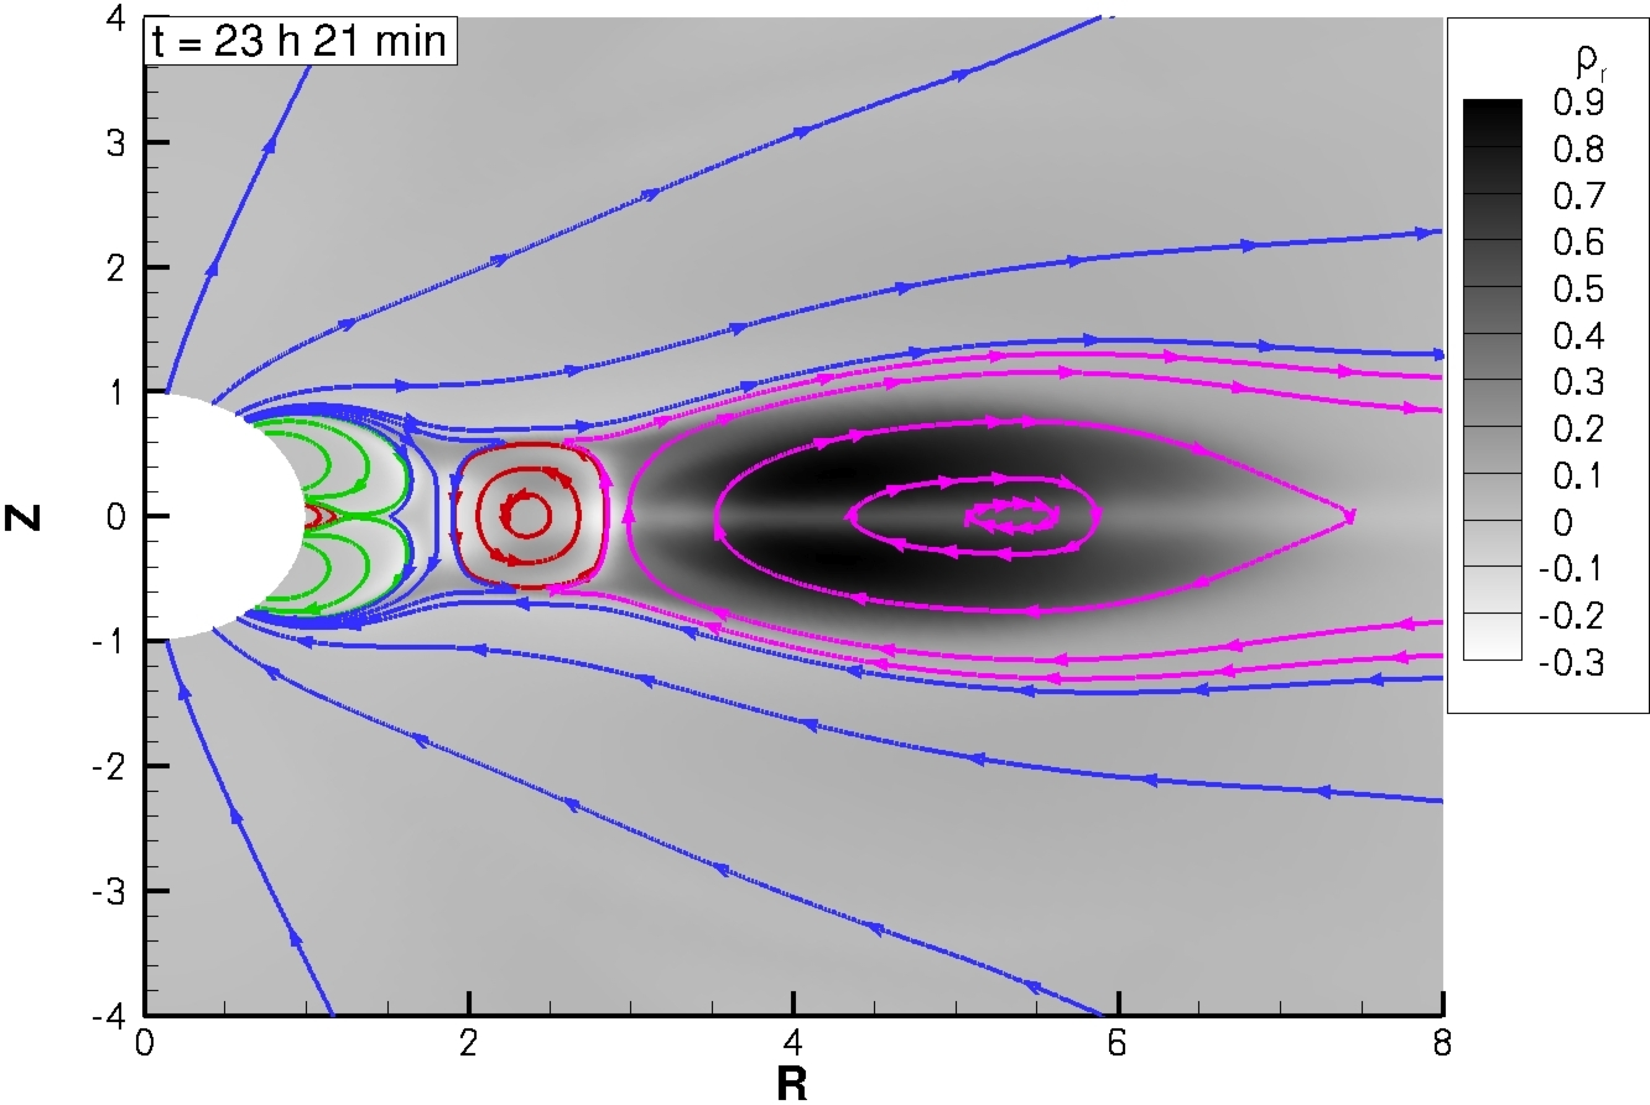
CME Formation (Bart van der Holst)

Slide 20
SWMF is Fully Operational
SWMF is available for the community
It is publicly available at http://csem.engin.umich.edu
It is available in “Runs-on-Request” mode at CCMC
There have been >700 SWMF/BATS-R-US runs at CCMC
SWMF/BATS-R-US is running 24/7 in real-time mode at CCMC since 2002
SWMF is operating at several partner institutions (JPL, Rice, U. Alberta, George Mason U.)
SWMF is user friendly and well documented
GUI
Parameter editor
~200 page User Manual
Peer reviewed publications are describing methodology and algorithms (available at http://csem.engin.umich.edu)

Slide 21
Future Work
Code development
Multi-fluid, Hall, anisotropic pressure, electron temperature
Physics applications
CME initiation, magnetosphere, GIC
Data assimilation
Quantitative validation
Transition to operations
NOAA SWPC, AFWA, AFRL, others if interested
Major ongoing projects
CCHM & CWMM: NASA LWS – NSF ATM – AFOSR strategic capabilities
VxO: Seamlessly combines simulation results with observations
CRASH: NNSA predictive science center – will develop high-performance radiation MHD code

