Slide 1
Edmonton Area Control Centre
Cross-Polar Air Traffic, Space Weather
&
HF Communications

Slide 2
Outline
Edmonton Area Control Centre Airspace
Arctic Air Traffic Flow Patterns
Intro to ATC
Polar Flight Challenges
How Space Weather affects ATC
How scientists can help us.

Slide 3
Edmonton Area Control Centre
Largest domestic Flight Information region in the World
3,600,000 mi²

Slide 4
Edmonton ACC Airspace above FL290
3.6 Million mi²

Slide 5
Edmonton Area Control Centre
Largest domestic Flight Information region in the World
3,600,000 mi²
Major crossroad
Western North America Europe

Slide 6
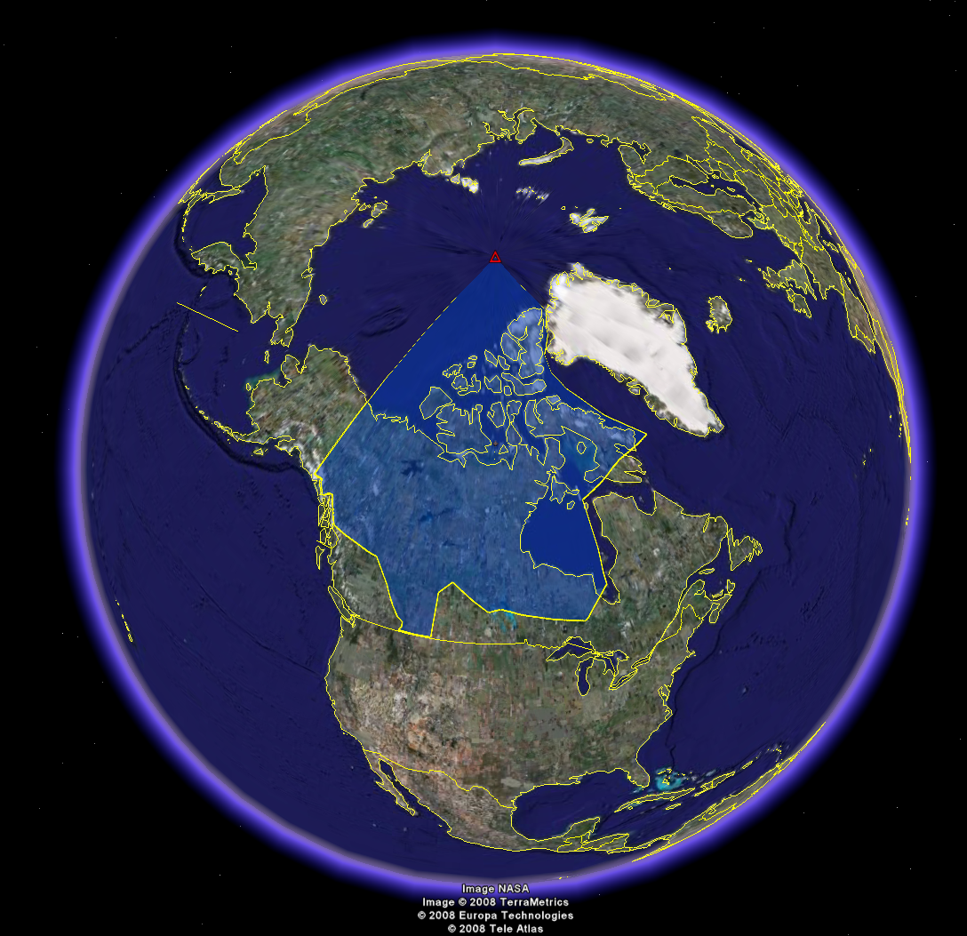

Slide 7
Edmonton Area Control Centre
Largest domestic Flight Information region in the World
3,600,000 mi²
Major crossroad
Western North America  Europe
Eastern North America Asia via Alaska

Slide 9
Edmonton Area Control Centre
Largest domestic Flight Information region in the World
3,600,000 mi²
Major crossroad
Western North America  Europe
Eastern North America  Asia via Alaska
Eastern North America  Asia via Polar gateways

Slide 11
Air Traffic Control’s Function
Safe, Orderly, Expeditious flow of air traffic
In the IFR domain (aircraft flying on instruments), ATC provides the separation between aircraft.

Slide 12
Vertical Separation – 1000 feet (in most cases)

Slide 14
Non-radar Lateral Separation - In the arctic, 60 nautical miles

Slide 15
Non-radar Longitudinal Separation 15 minutes
(CMNPS airspace)

Slide 16
Under certain conditions 10 minutes

Slide 18
Polar Flights
Most Challenging
Fuel-critical
Payload-limited
Beyond Direct Controller – Pilot Communications (VHF)
Rely on relayed High Frequency (HF) Family D in arctic (2.9 – 13.3 KHz)
Satellite communications emerging

Slide 19
Polar Flights
Most Challenging
Fuel-critical
Payload-limited
Beyond Direct Controller – Pilot Communications (VHF)
Rely on relayed High Frequency (HF) Family D in arctic (2.9 – 13.3 KHz)
Satellite communications emerging.

Slide 20
North American Airports Anchoring Polar Flights
Notes:
Currently New York (both Newark & JFK), Washington(Dulles), Toronto, Atlanta & Chicago.
LAX & SFO expected soon.

Slide 21
Asian Airports served by Polar Flights
Notes:
Currently: Beijing, Hong Kong, Shanghai, Bangkok. Occasionally Incheon and Tokyo. Dubai and Delhi are expected soon.
More airports are continuously added

Slide 22
Sample Polar Great Circle Routes

Slide 23
Sample Polar Great Circle Routes with Comms

Slide 24
Communications

Slide 25
Polar Gateways

Slide 26
One day’s trajectories over a fix
Red Lines: GCRs
Yellow Lines: actual trajectories

Slide 27
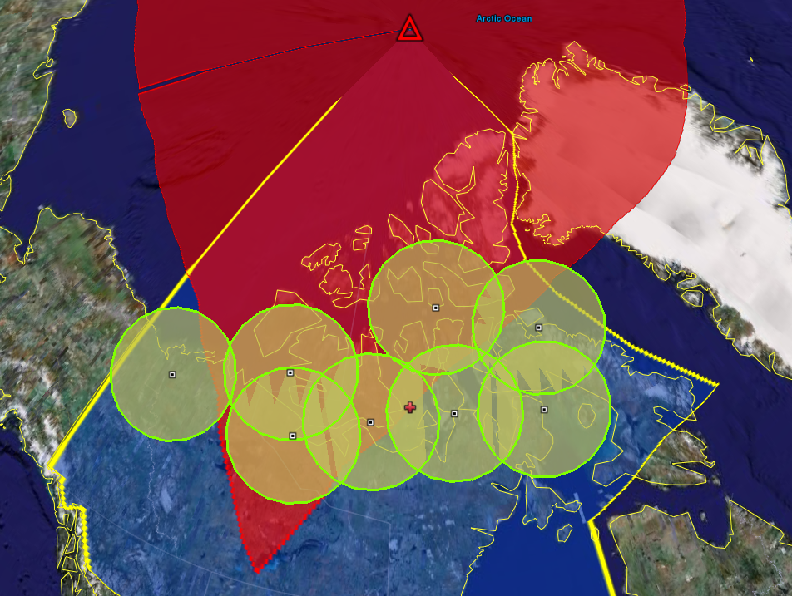

Slide 28
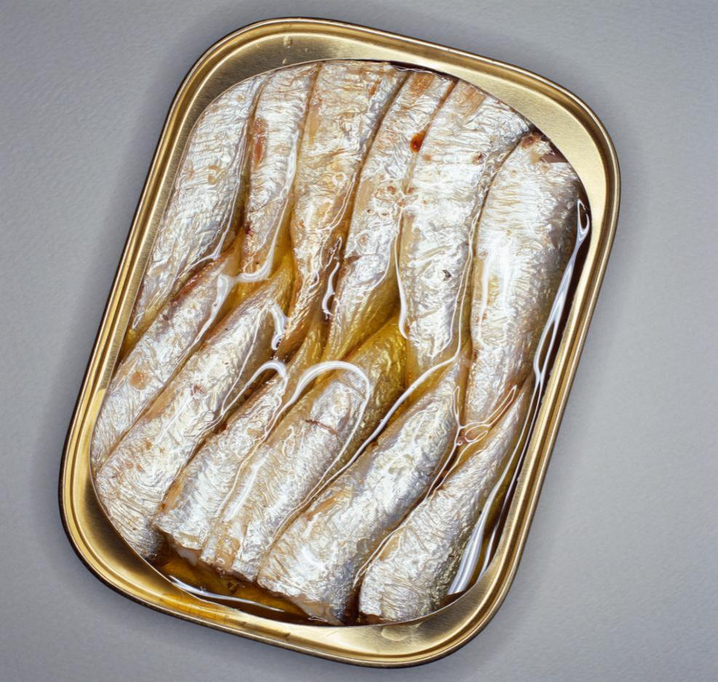
Things get kinda tight…
Notes:
To insert this slide into your presentation
Save this template as a presentation (.ppt file) on your computer.
Open the presentation that will contain the image slide.
On the Slides tab, place your insertion point after the slide that will precede the image slide. (Make sure you don't select a slide. Your insertion point should be between the slides.)
On the Insert menu, click Slides from Files.
In the Slide Finder dialog box, click the Find Presentation tab.
Click Browse, locate and select the presentation that contains the image slide, and then click Open.
In the Slides from Files dialog box, select the image slide.
Select the Keep source formatting check box. If you do not select this check box, the copied slide will inherit the design of the slide that precedes it in the presentation.
Click Insert.
Click Close.

Slide 30
April 15, 2008 - Colour Coded

Slide 31
Polar Caravan

Slide 32
Situation
Critical flights
Large amounts of spacing
60 miles laterally
15 minutes longitudinally ( ~120 nautical miles)
Limited flight levels
320
340
380

Slide 33
Situation
Critical flights
Large amounts of spacing
60 miles laterally
15 minutes longitudinally ( ~120 nautical miles)
Limited flight levels
320
340
380.

Slide 34
Requested Altitude Change
Pilot passes request to Gander Radio
Gander transmits message to controller
Controller issues clearance to Gander Radio
Gander Radio relays clearance to pilot

Slide 35
Then – Just as things are going well….
Credit: SOHO Consortium, ESA, NASA

Slide 36
Geomagnetic Storm
HF Blackout
Varying geographic area
Err on the side of safety
Satellite Feeds may be lost
Satellite relay of VHF frequencies may be lost
GPS accuracy may be compromized

Slide 37
Mitigation
We are REACTING
We don’t like to react….
Increased longitudinal separation
Due to uncertainty of aircraft positions
More conservative style of control
Solve problems earlier
Assume we will not hear back from the aircraft
Reduced capacity

Slide 38
How Space Weather Science can help
Give us as much notice as possible
Graphical & geographical products
Easily & rapidly understandable by non-scientists
Categorize:
HF blackout?
Satellite blackout? loss?
Duration of effects

Slide 39
Questions?

Slide 41
Edmonton Area Control Centre
April 2008

Slide 42
CZEG
With NAM airports

Slide 43
April 15 zoomed

